Slide 1
Five Star Chef
Demo for 301 project - Team 21

Slide 2
Rui Huang
Wentao Lu
Yuxing Chen
Shiming Zhang
Xiangguang Wang
Kaiyuan Yang
REPRESENTS

Slide 3
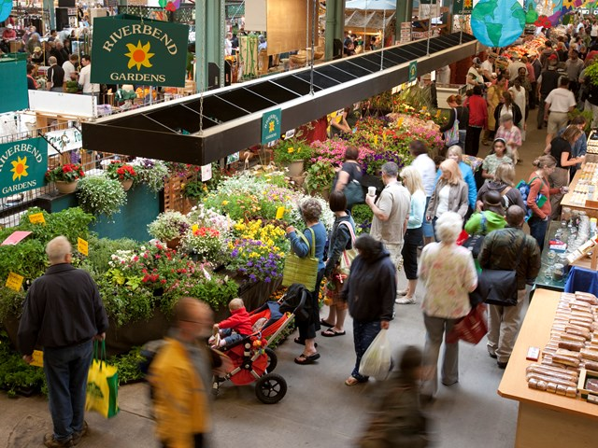
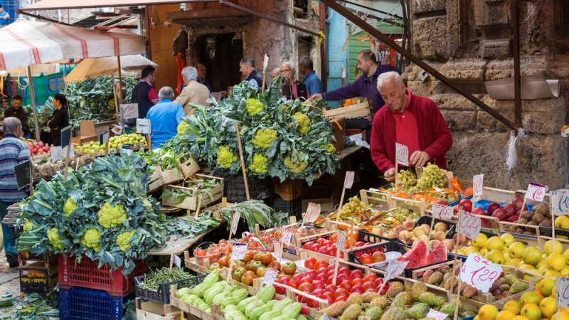
IN THE MARKET

Slide 4
PURPOSE OF THE PROJECT
With the popularity of personal mobile devices, we need a mobile application to help users record personal meal plans and manage food inventory at home.
Help users generate shopping lists to improve user purchasing efficiency.

Slide 5
Why should your next meal plan management be on paper?

Slide 6
Here is our solution

Slide 7
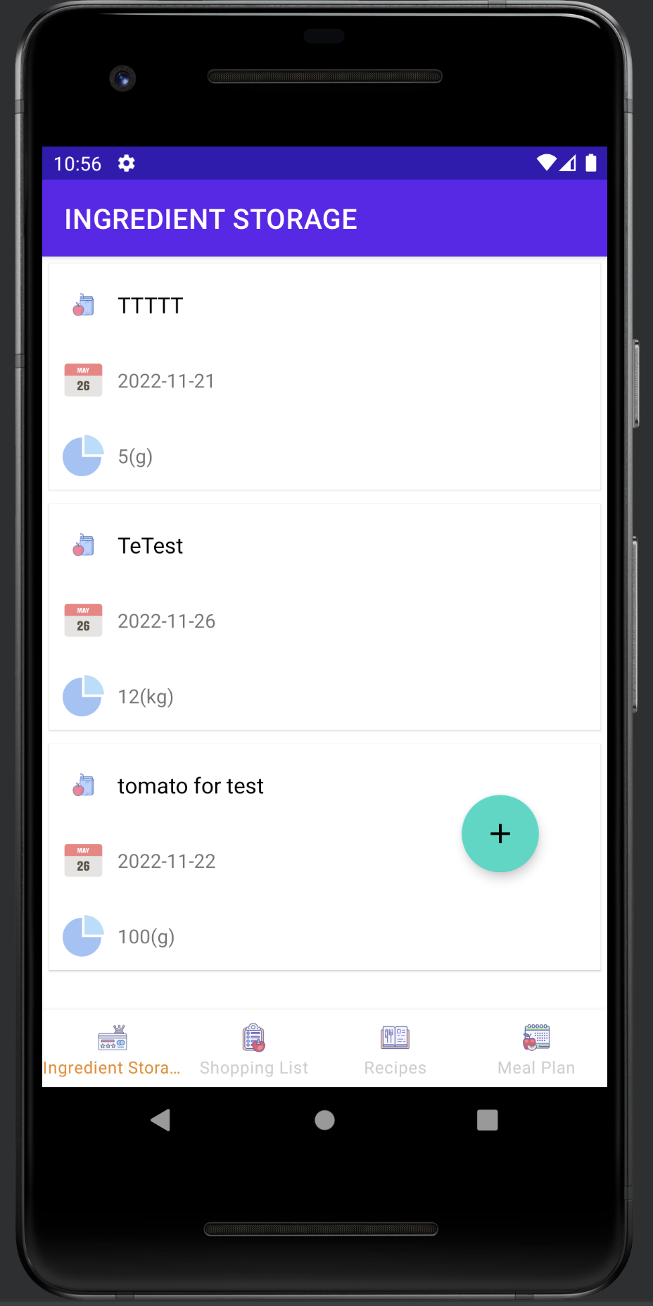
This is the demo interface of the application.
Our projects follow the principles of humanized design.
The operation logic is the same as Twitter. At the bottom of the application interface, we can see that the entire application is divided into four modules:
ingredient storage, shopping list, recipes, meal plan.

Slide 8
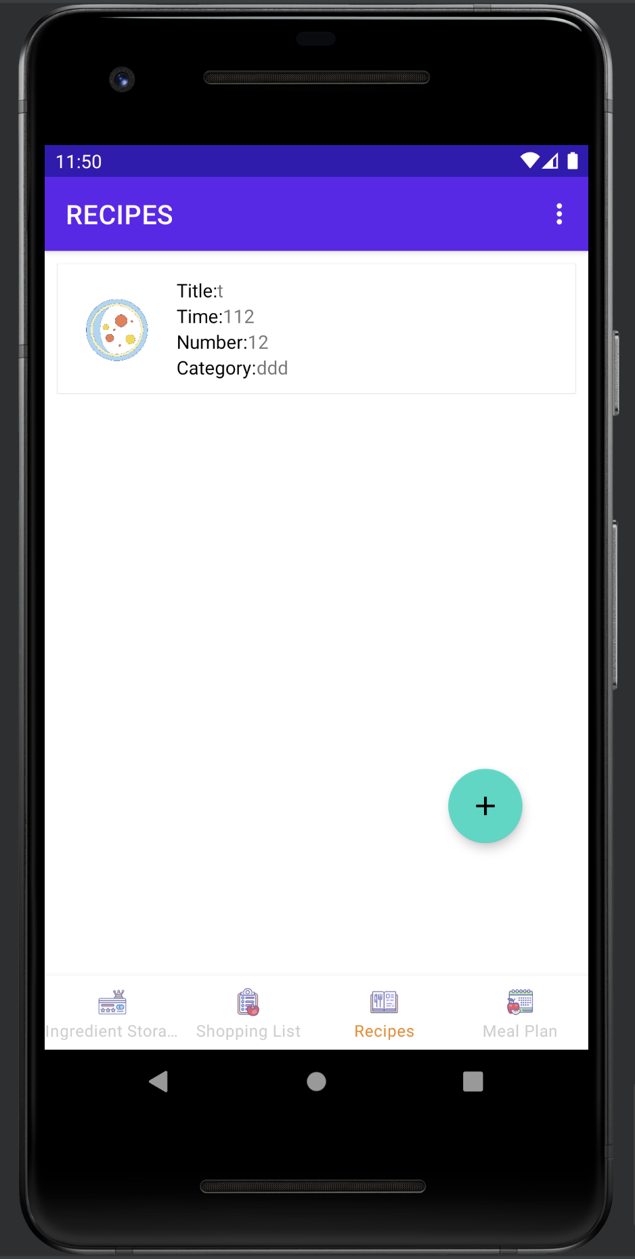
In order to optimize the user experience, the system has a built-in recipe function, and users can collect and record the preparation methods of their favorite dishes. In the future, users can directly follow recipes and add ingredient requirements to their own meal plans in combination.

Slide 9
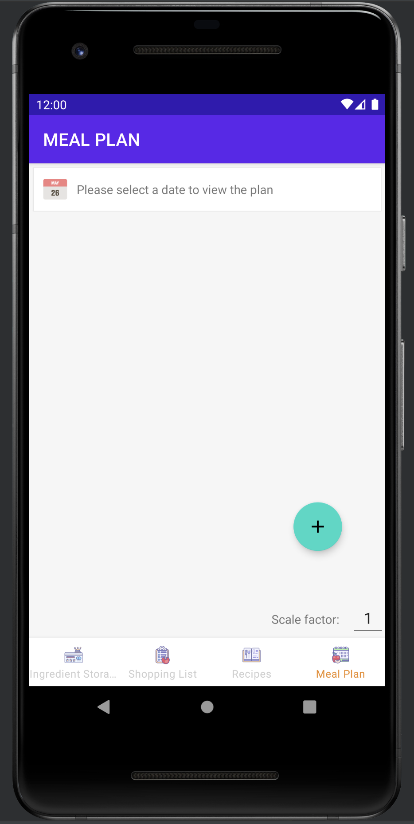
This page is used to create a personal meal plan.
For the user's experience, the system presets two adding methods. Add from current food reserves, or directly from recipes.
For home users, a multiplication function is specially designed, which can directly double the amount of ingredients.

Slide 10
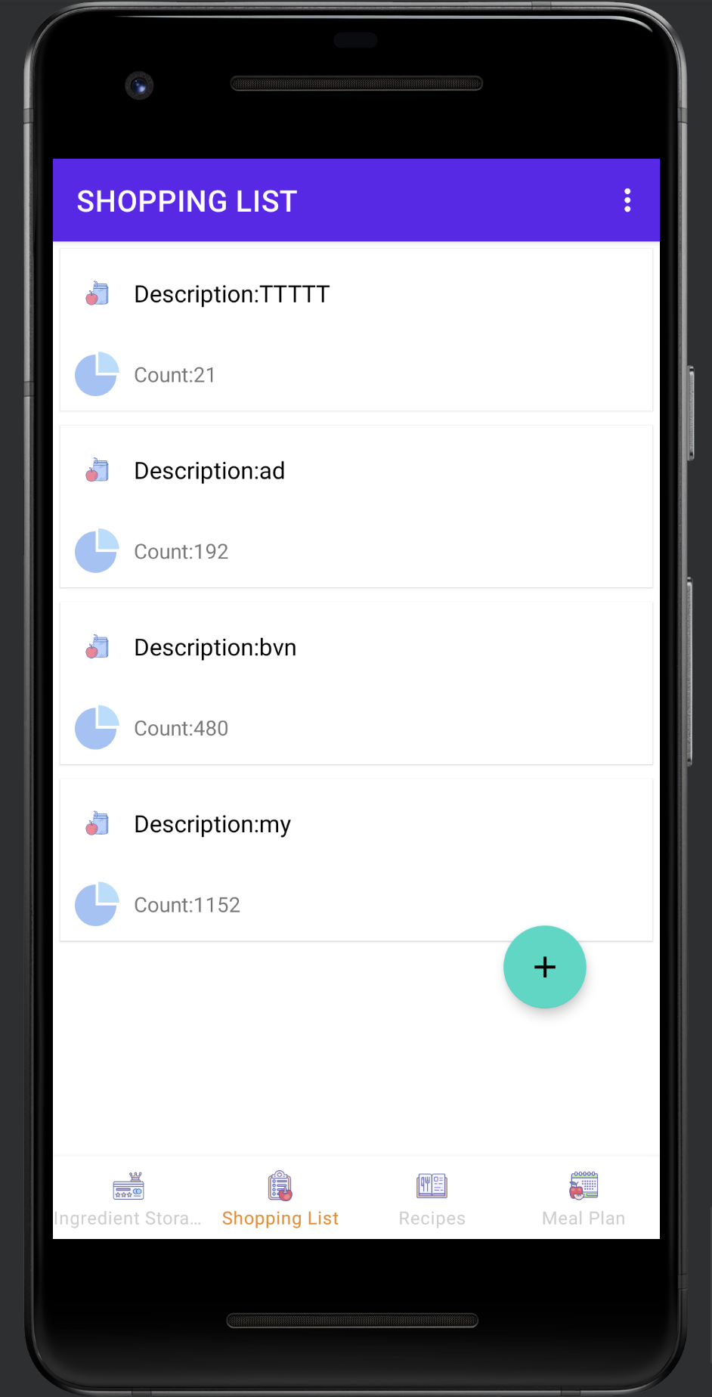
According to the current material inventory and the user's meal plan, the system will automatically generate the user's purchase list.
It is intended to help users quickly find purchase targets in the complicated farmers' markets, saving time and improving users' shopping efficiency.

Slide 11
Demonstration on real machine

Slide 12
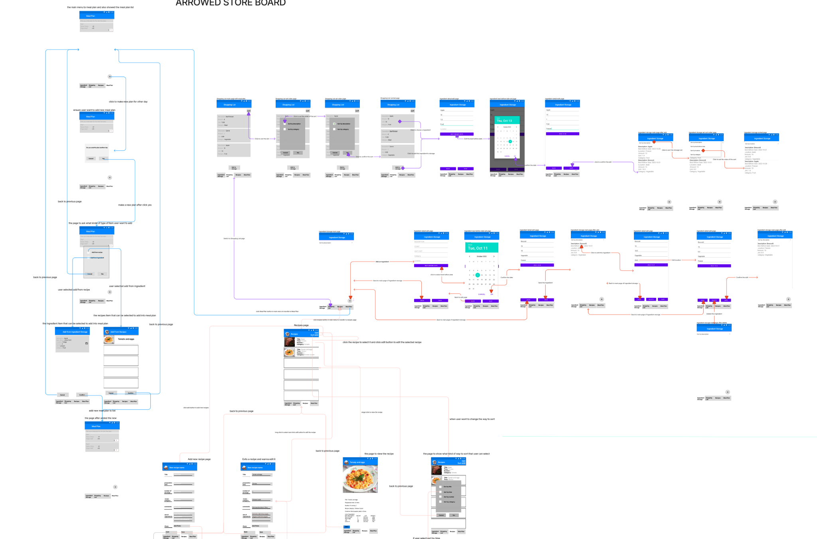

Slide 13
Thanks for your patience

